Slide 1


Slide 2
Profile Book– A Social Media Platform
Name: Pratiksha Jagtap
Batch: WIPRO NGA – .Net Full Stack Angular – FY26 – C2
Instructor: Jyoti Patil Ma’am
Date: 08/09/2025

Slide 3
Problem Statement & Objectives
Problem: Existing platforms are either complex or lack administrative control.
Objectives:
- Secure login/registration for users and admins
- Users can create posts, like, comment, and message
- Admin can approve posts, manage users, and handle reports
- Responsive frontend and scalable backend

Slide 4
System Requirements
Frontend: Angular UI
Backend: ASP.NET Core MVC + Web API, JWT Authentication
Database: SQL Server with EF Core
File Storage: Profile & Post Images
API Docs: Swagger

Slide 5
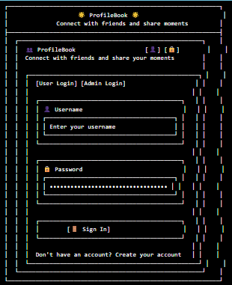
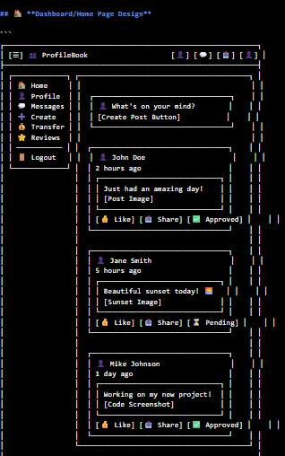
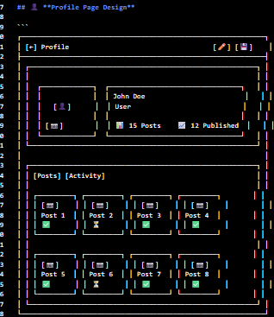
Architecture Overview

Slide 6
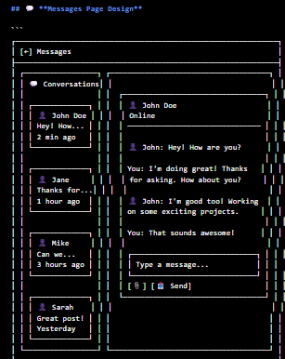
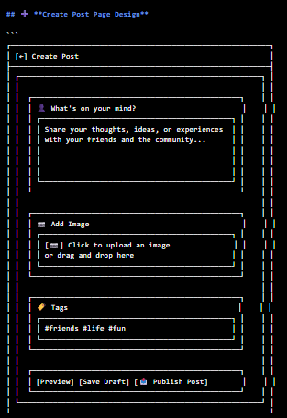
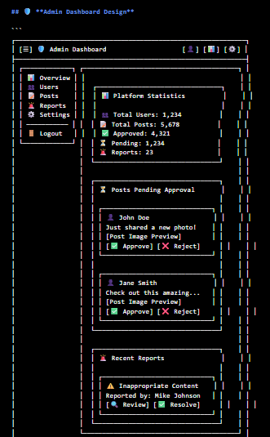
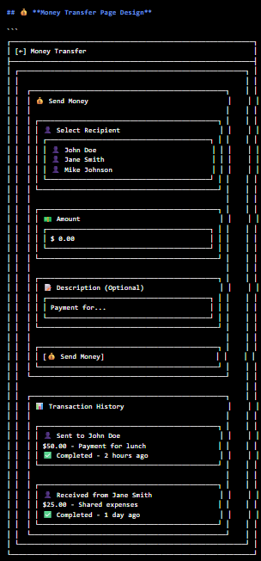

Slide 7
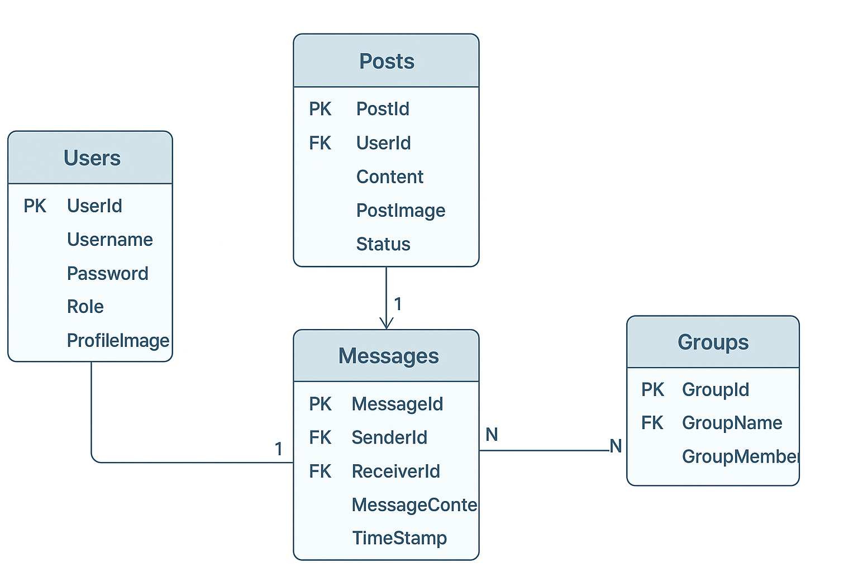
Database ERD

Slide 8
Sprint Plan
Sprint I: Use Cases, DB Schema, Static Frontend
Sprint II: Angular UI, Web API, JWT Auth, Messaging API
Sprint III: Search & Filter, Post Approval, Reported Users, Swagger, Final Integration

Slide 9
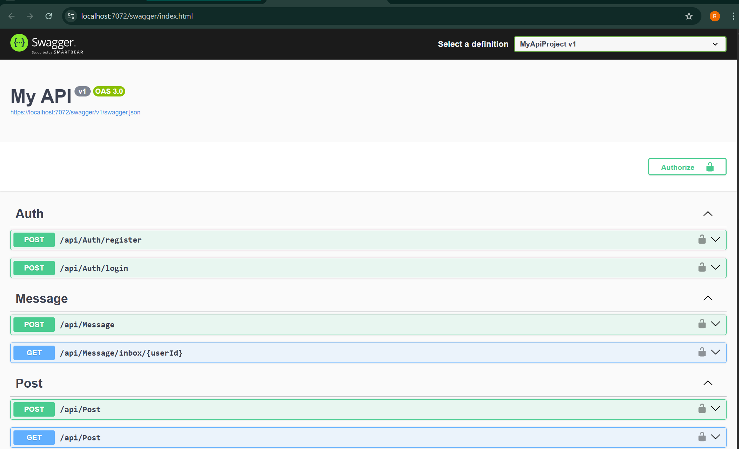
Backend outputs:

Slide 10
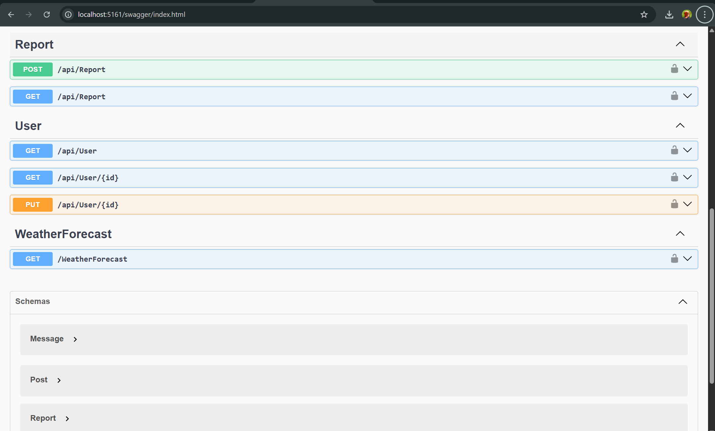

Slide 11
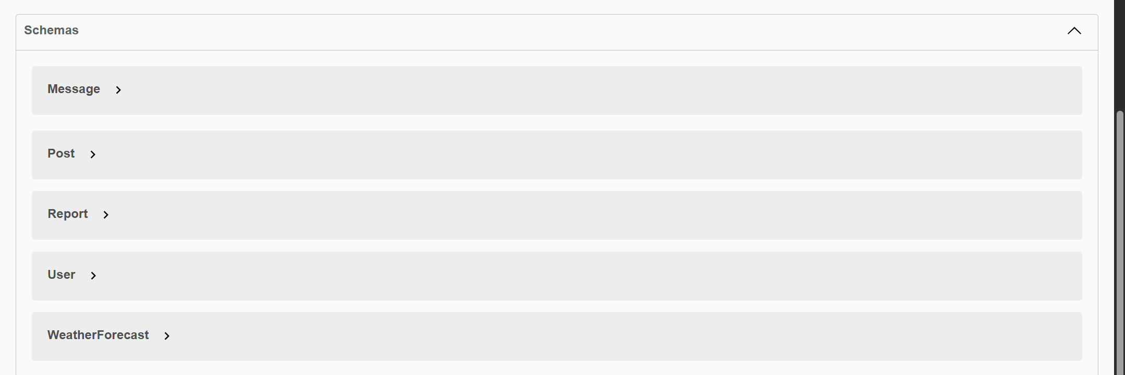

Slide 12
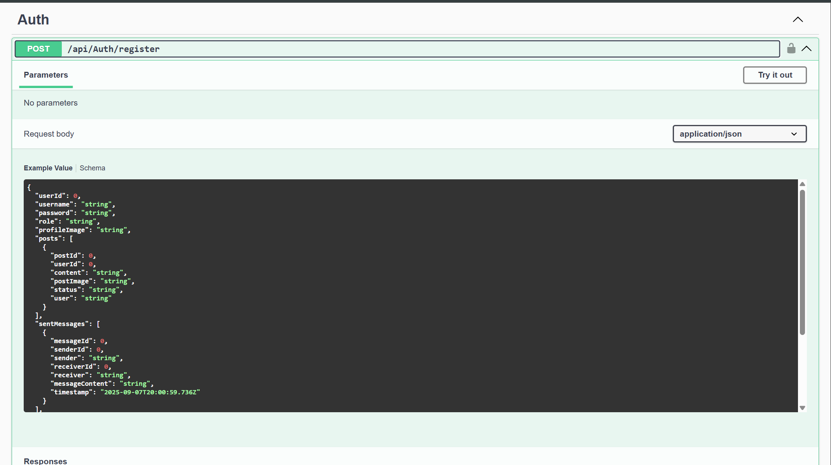

Slide 13
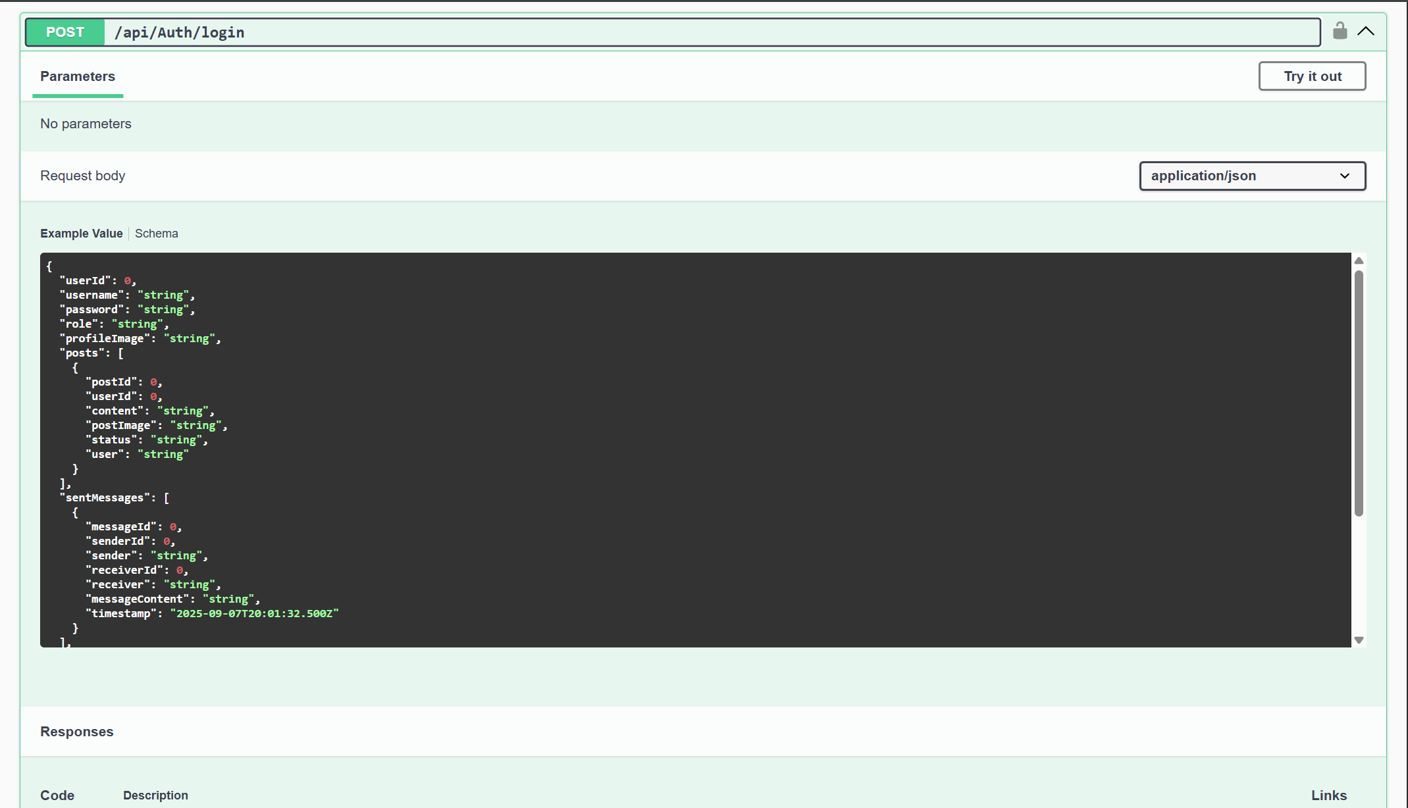

Slide 14
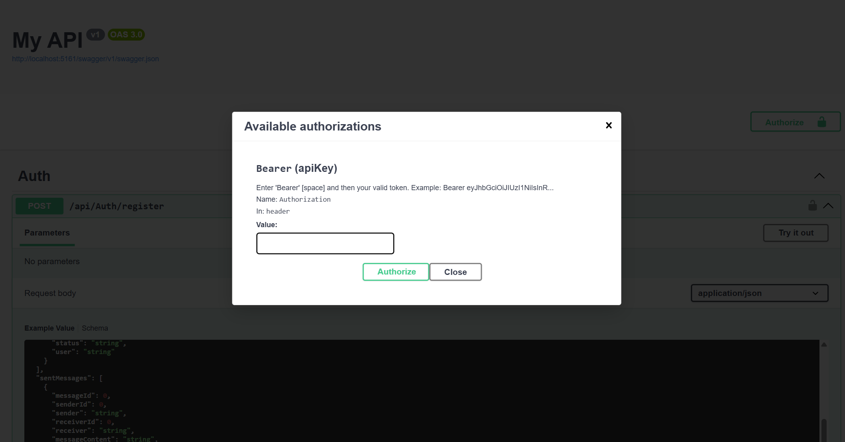

Slide 15
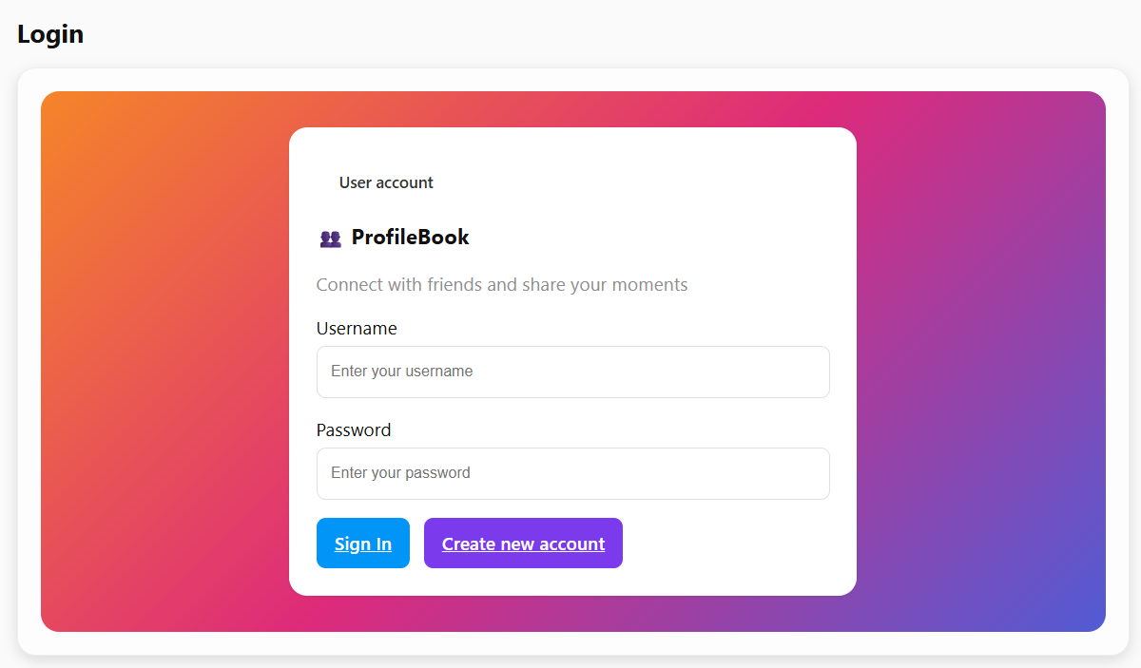
Frontend outputs:

Slide 16
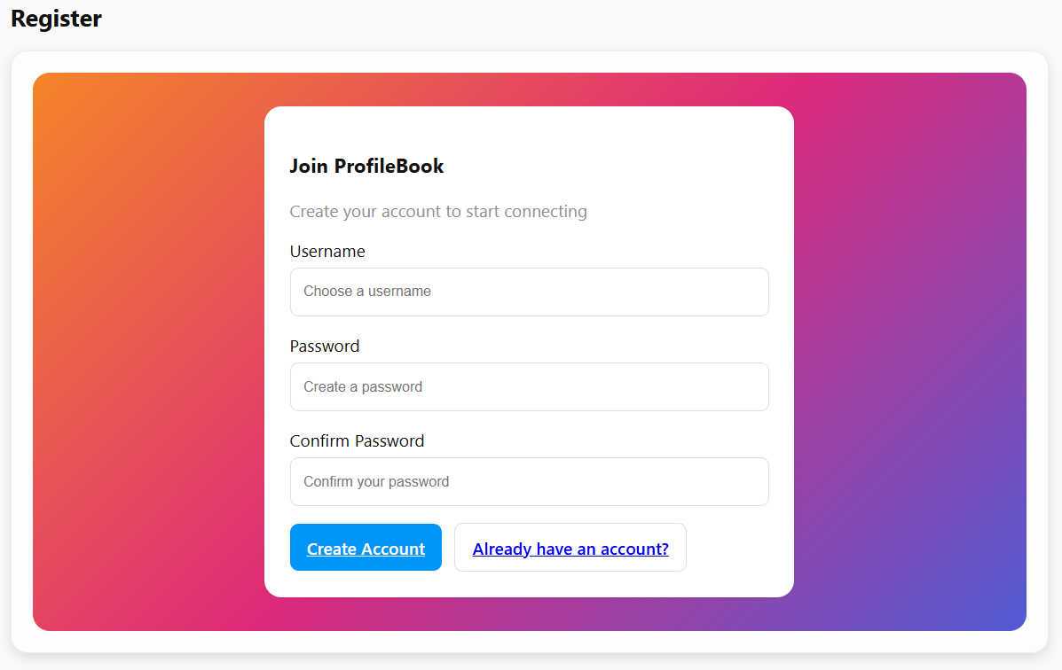

Slide 17
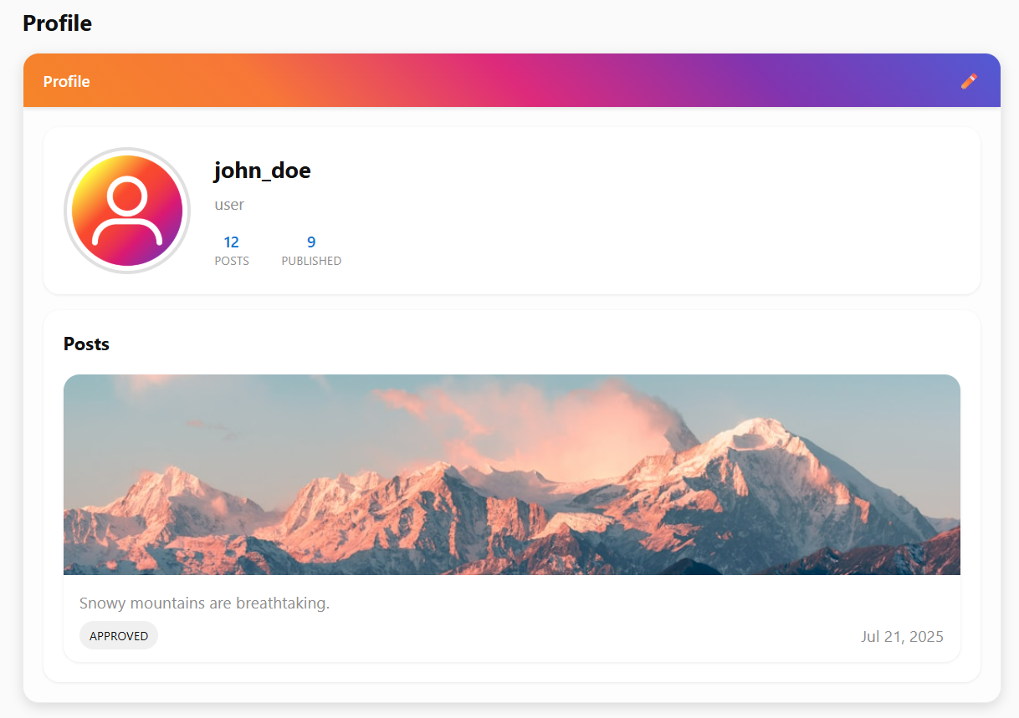

Slide 18
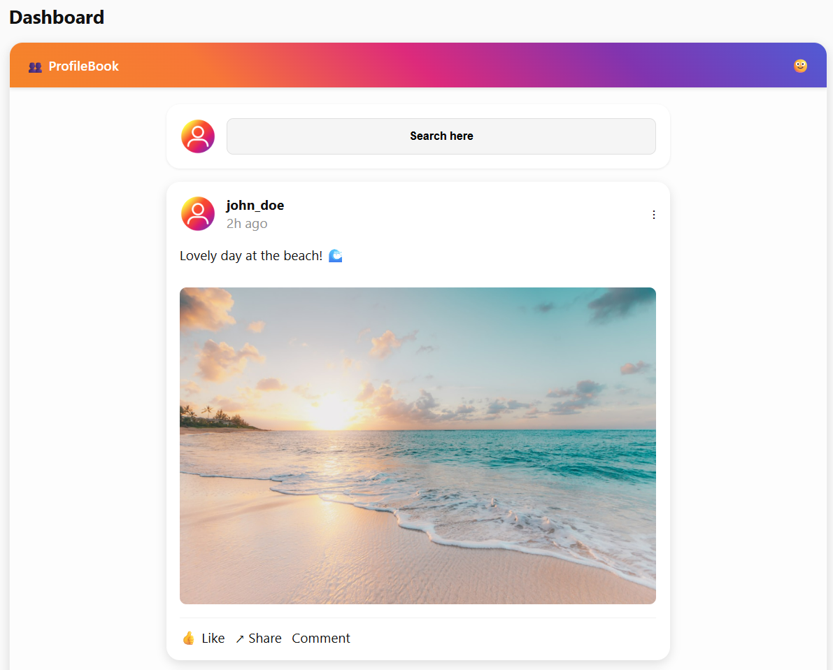

Slide 19
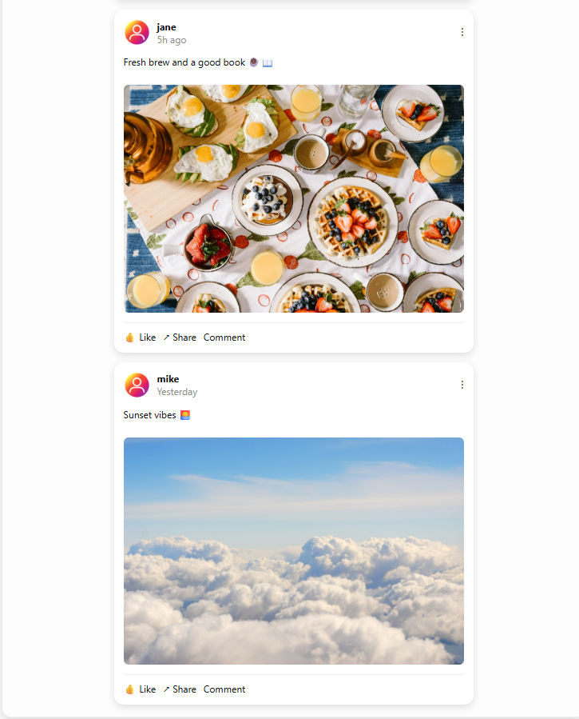
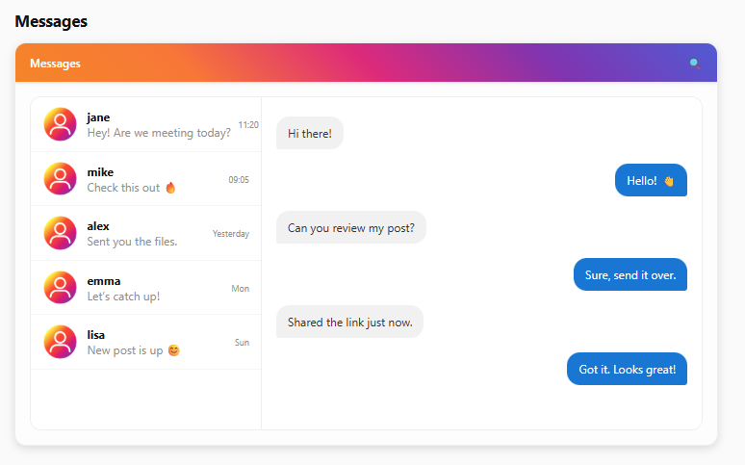

Slide 20
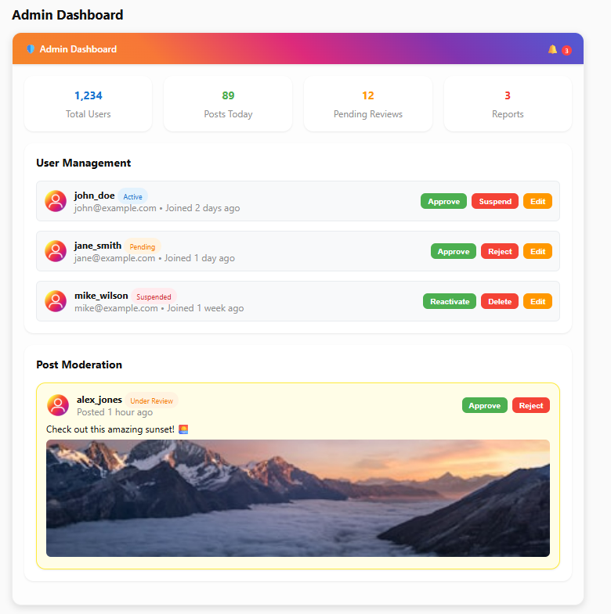
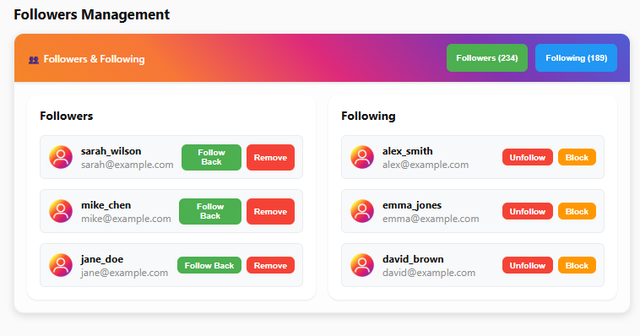

Slide 21
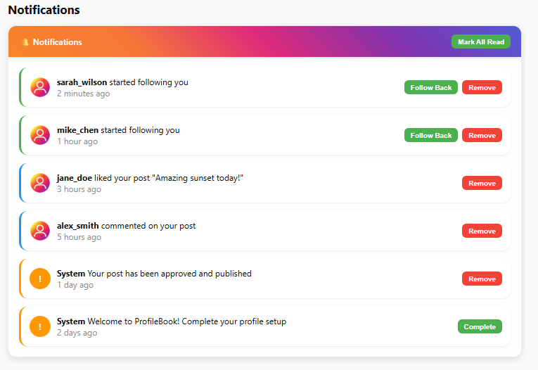

Slide 22
Future Enhancements
Realtime notifications via SignalR
Advanced search & filtering
Improved UI/UX
Automated testing & deployment

Slide 23
References
Microsoft ASP.NET Core Documentation
Angular Official Documentation
TutorialsPoint – ASP.NET & Angular
GeeksforGeeks – Entity Framework Core

Slide 24


